Slide 1
Introduction to HTML / CSS

Slide 2
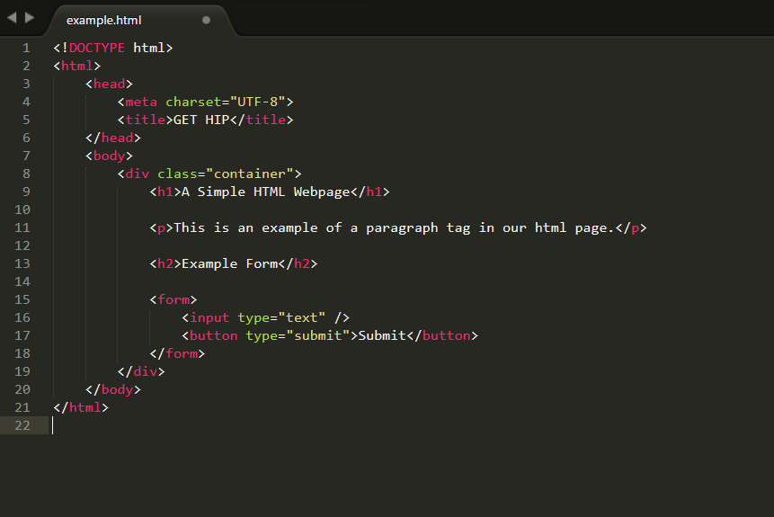
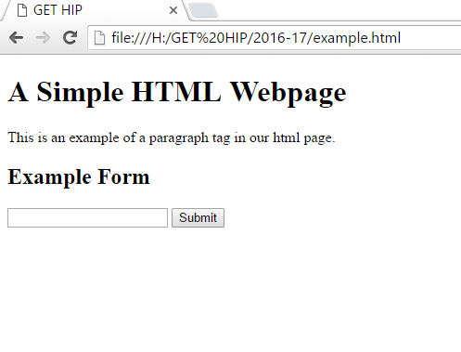
HTML (HyperText Markup Language)

Slide 3
<Tags>
Tags describe different types of document content
Each html page has one each of the following tags:
<html>
A container to house all other tags
<head>
A place to
<body>
Content displayed on the page
Must end every tag block with a closing tag </tagname>
A tag paired with a closing tag is known as an element
Notes:
Ask for examples of problems that can or have been solved using computer science.

Slide 4
Other <Tags>
Tags that can be found in <head>
<meta>
Contains info about the page
<title>
Text displayed on the tab
Tags that can be found in <body>
<h1>, <h2>, <h3>, <h4>, <h5>, <h6>
Heading tags from largest to smallest
<p>
Paragraph tag for normal text
<form>
Wrapper for user input
<input>
Used for text, checkbox, radio, etc.
<button>
Notes:
Ask for examples of problems that can or have been solved using computer science.

Slide 5
Attributes
Tags can have extra information in the form of attributes
<tag attribute=“value”>
The <meta> tag can have an attribute of charset
<meta charset=“UTF-8”>
Notes:
Ask for examples of problems that can or have been solved using computer science.

Slide 6
Links and Images
Links are created with the <a> (anchor) tag
<a href=“http://example.com”>An Example Link</a>
The href attribute defines where the link will go
Images are created with the <img> tag
<img src="http://www.htmldog.com/badge1.gif" width="120" height="90" alt="HTML Dog">
The src attribute defines where to get the image
The width and height attributes set the dimensions on the webpage
The alt text will display when the image is not found

Slide 7
CSS (Cascading Style Sheet)

Slide 8
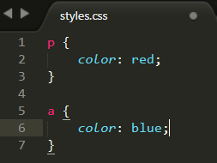
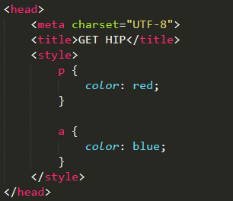
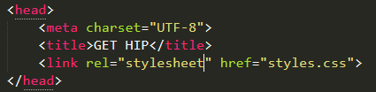
Where to Implement CSS? (three ways)
Inline
Internal
External

Slide 9
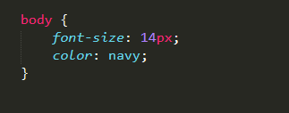
Selectors, Properties, and Values
A selector is the name given to a style in a stylesheet
For each selector, properties can be defined inside curly brackets
Each property can have a value associated with it
Selector
Properties
Values

Slide 10
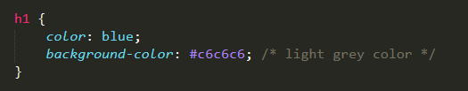
Colors
Can be represented by name, RGB value, or hex code
red
rgb(255,0,0)
#ff000
Can be used for the “color” and “background-color” properties
“color” corresponds to the color of the text
“background-color” sets the color behind the html element

Slide 11
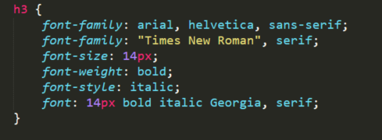
Text Styling
font-family: arial, helvetica, sans-serif;
The font itself
If font is more than one word, use quotes
font-family: “Times New Roman”, serif;
font-size: 14px;
Can use px, em, pt, %
font-weight: bold;
Can use normal, bold, 100, 200, 300, 400 (normal), 500, 600, 700 (bold), 800, or 900
font-style: italic;
Font properties can all be set in one declaration
font: 14px bold italic Georgia, serif;

Slide 12
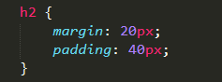
Margin and Padding
margin and padding are the two most commonly used properties for spacing-out elements
margin is the space outside something
padding is the space inside something
The four sides of an element can also be set individually
margin-top, margin-right, margin-bottom, and margin-left
padding-top, padding-right, padding-bottom, and padding-left

Slide 13
Borders
border-style: dashed;
Can use solid, dashed, and dotted
border-width: 3px;
border-color: black;
Can combine these properties
border: 2px solid black;

Slide 14

The Box Model
Margins, padding and borders are all part of the Box Model

Slide 15
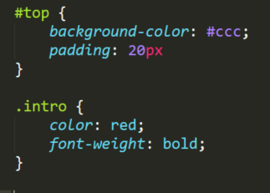
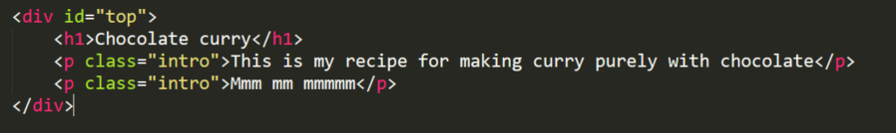
Class and ID Selectors
You can define your own selectors in the form of class and ID selectors
In CSS a class selector is denoted by a period (“.”) and an ID selector is denoted by a hash character (“#”)

